Slide 1
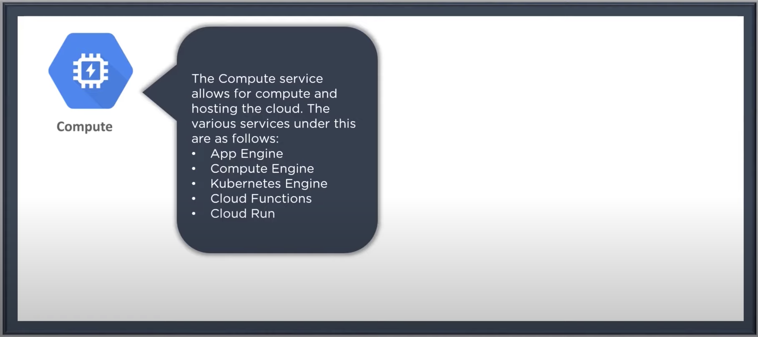
Google Cloud Platform Domains

Slide 2
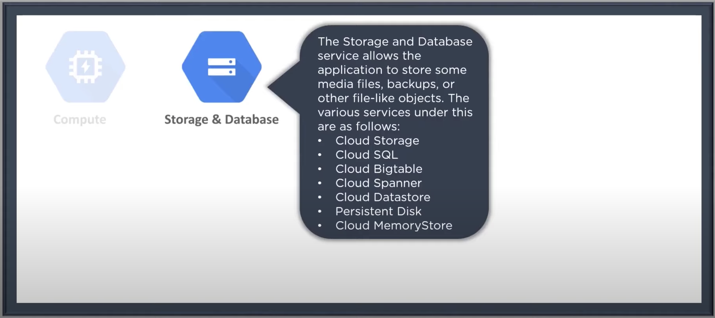
Google Cloud Platform Domains

Slide 3
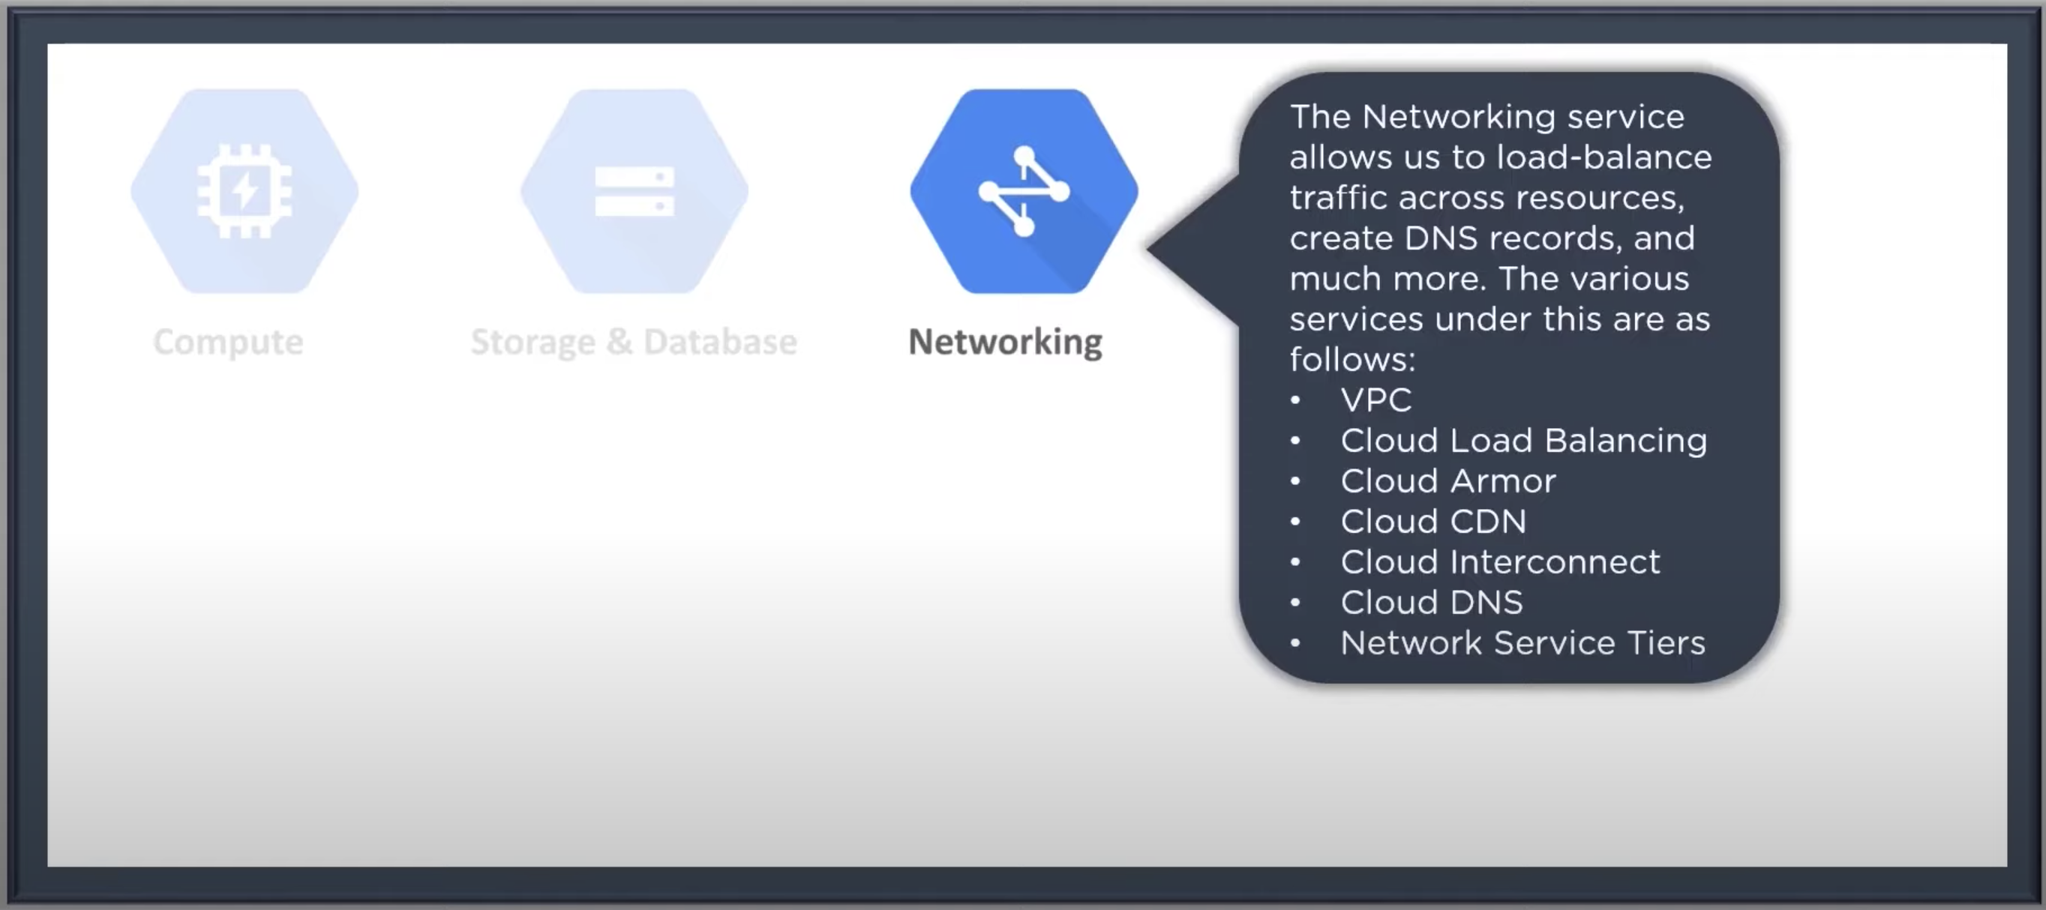
Google Cloud Platform Domains

Slide 4
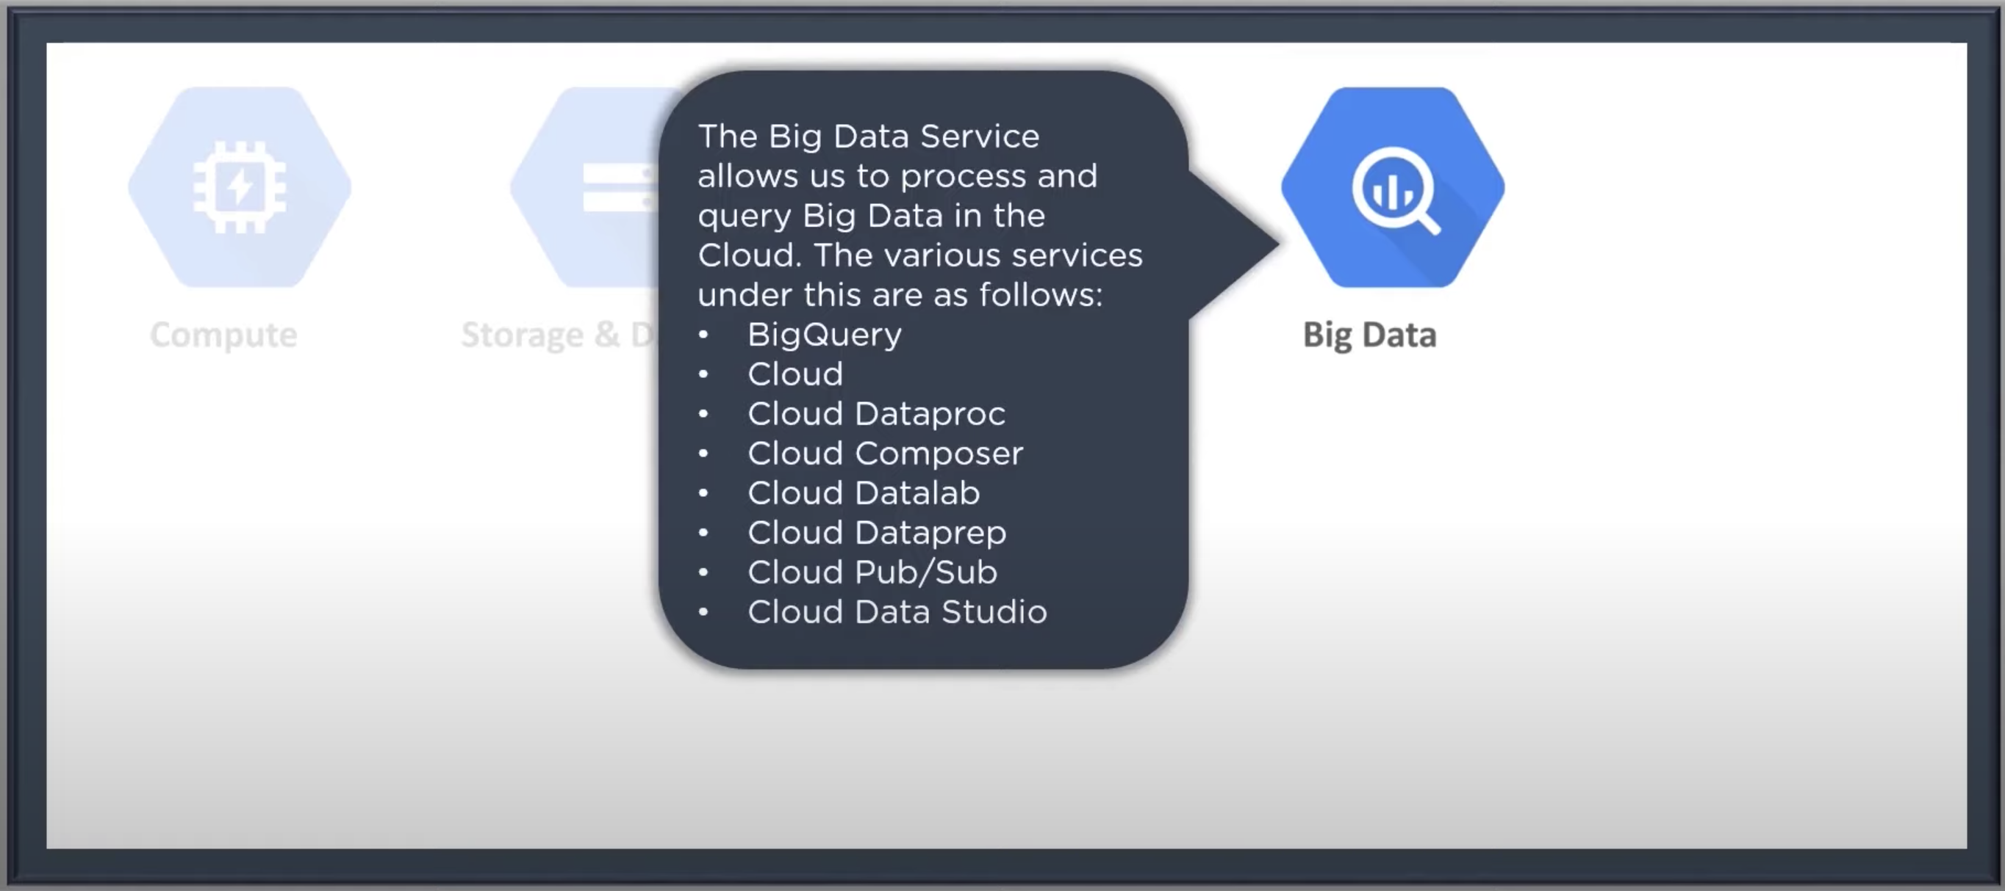
Google Cloud Platform Domains

Slide 5
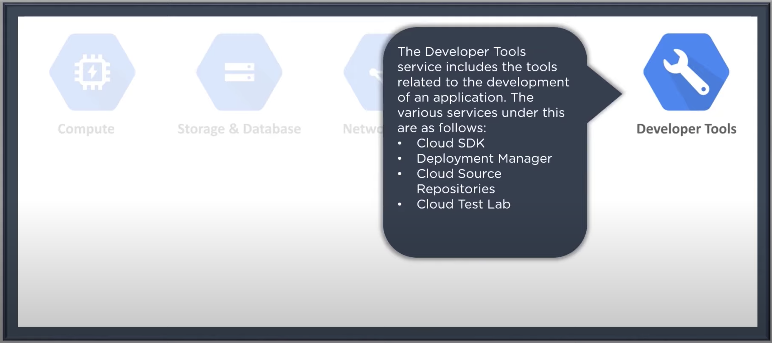
Google Cloud Platform Domains

Slide 6
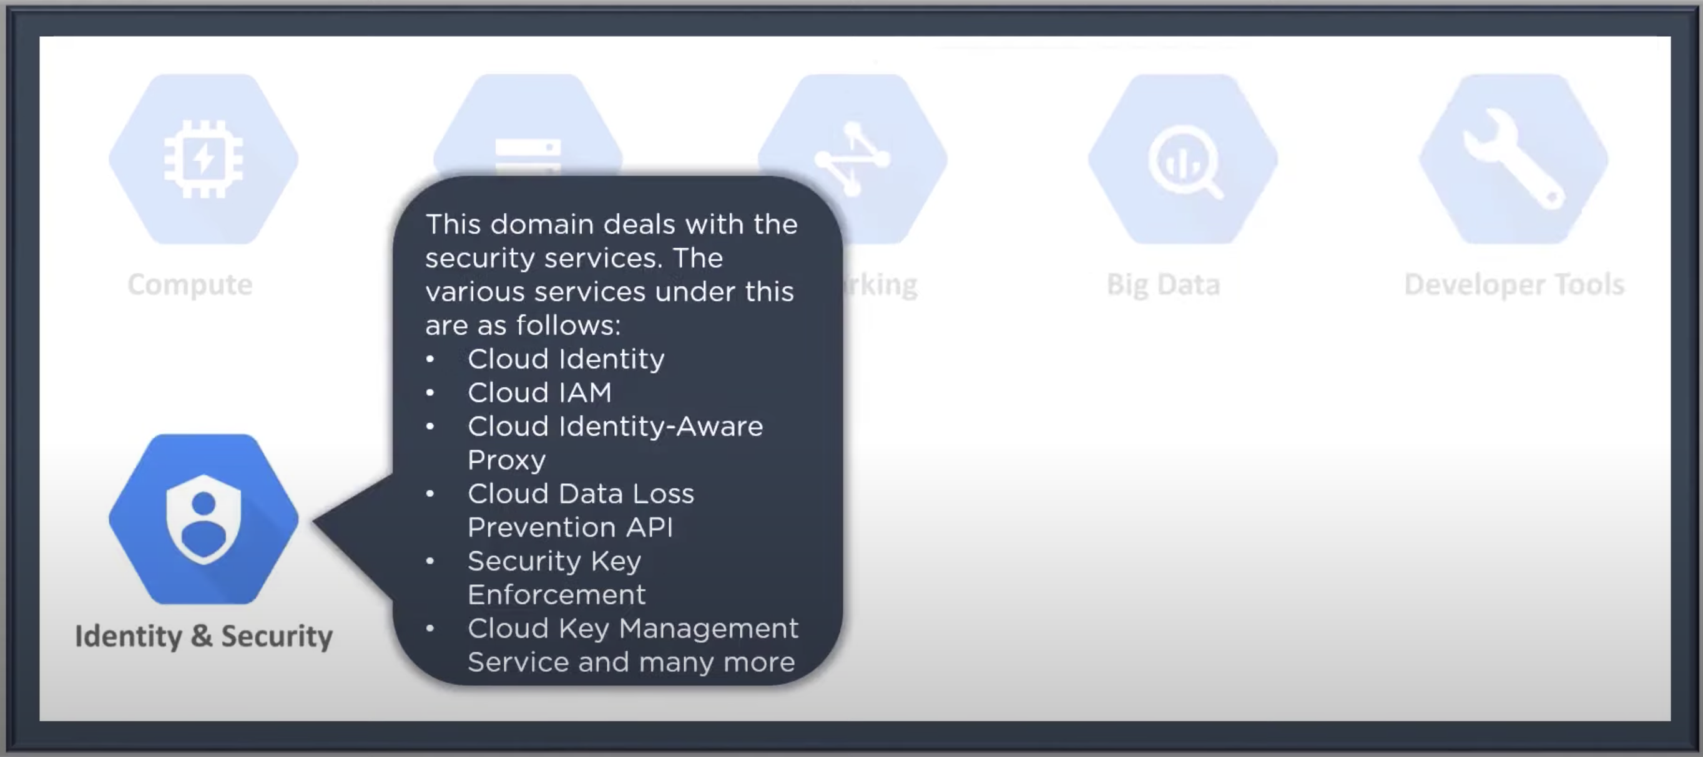
Google Cloud Platform Domains

Slide 7
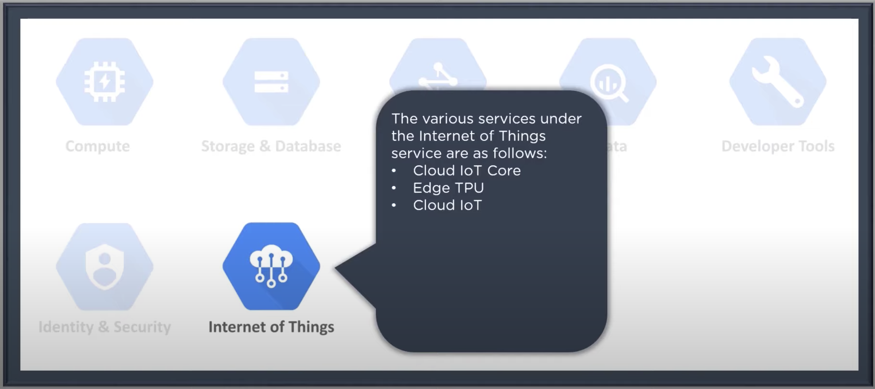
Google Cloud Platform Domains

Slide 8
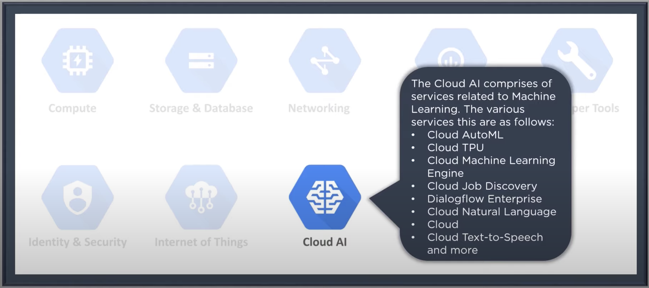
Google Cloud Platform Domains

Slide 9
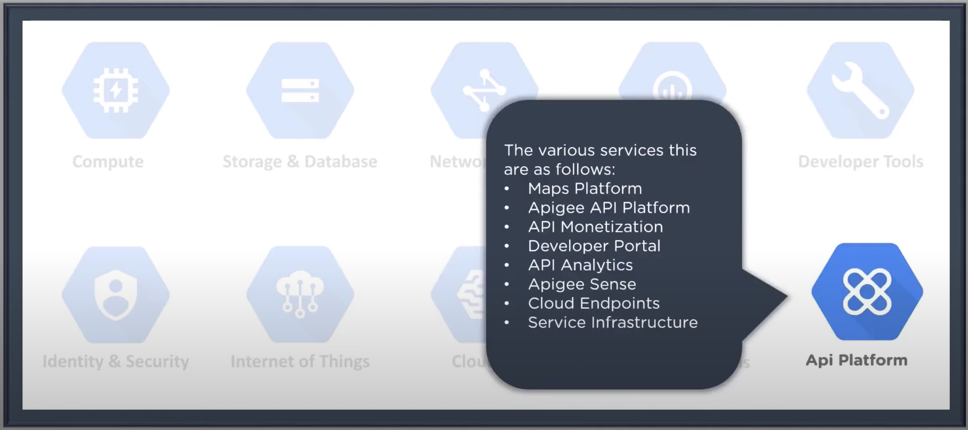
Google Cloud Platform Domains

Slide 10
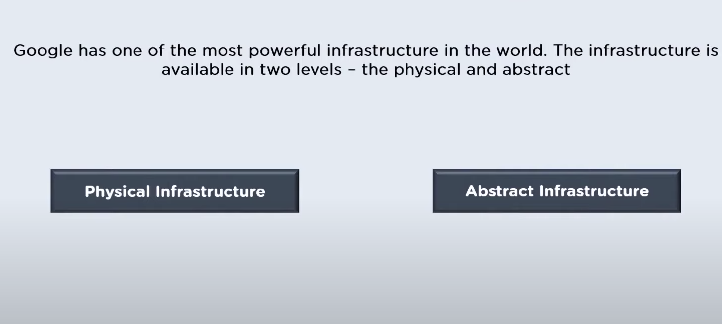
Google Infrastructure

Slide 11
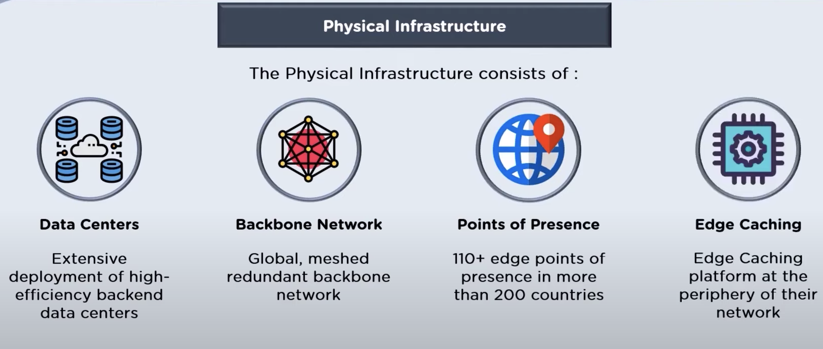
Google Infrastructure

Slide 12
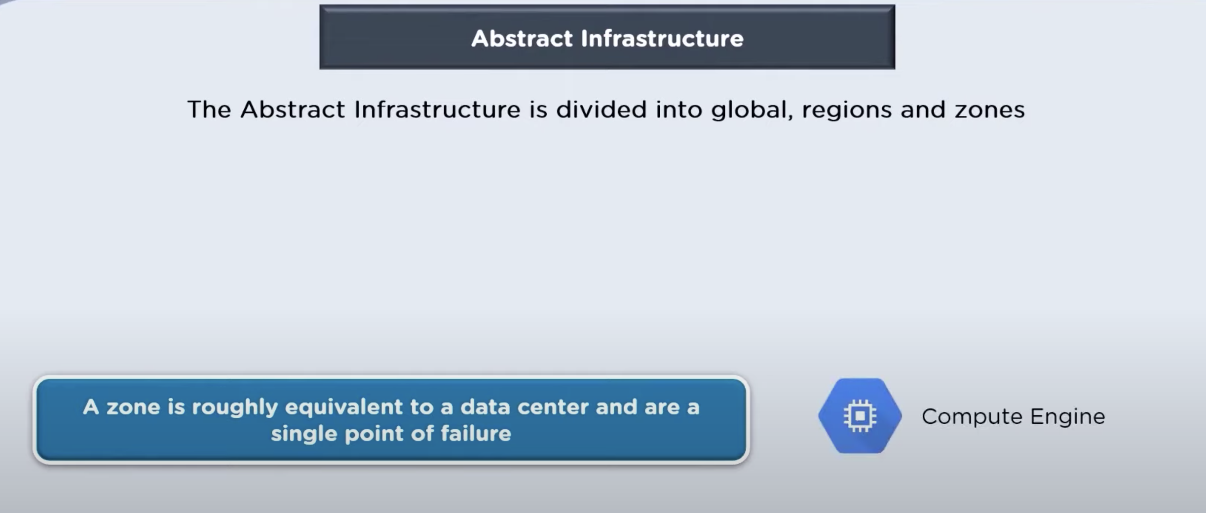
Google Infrastructure

Slide 13
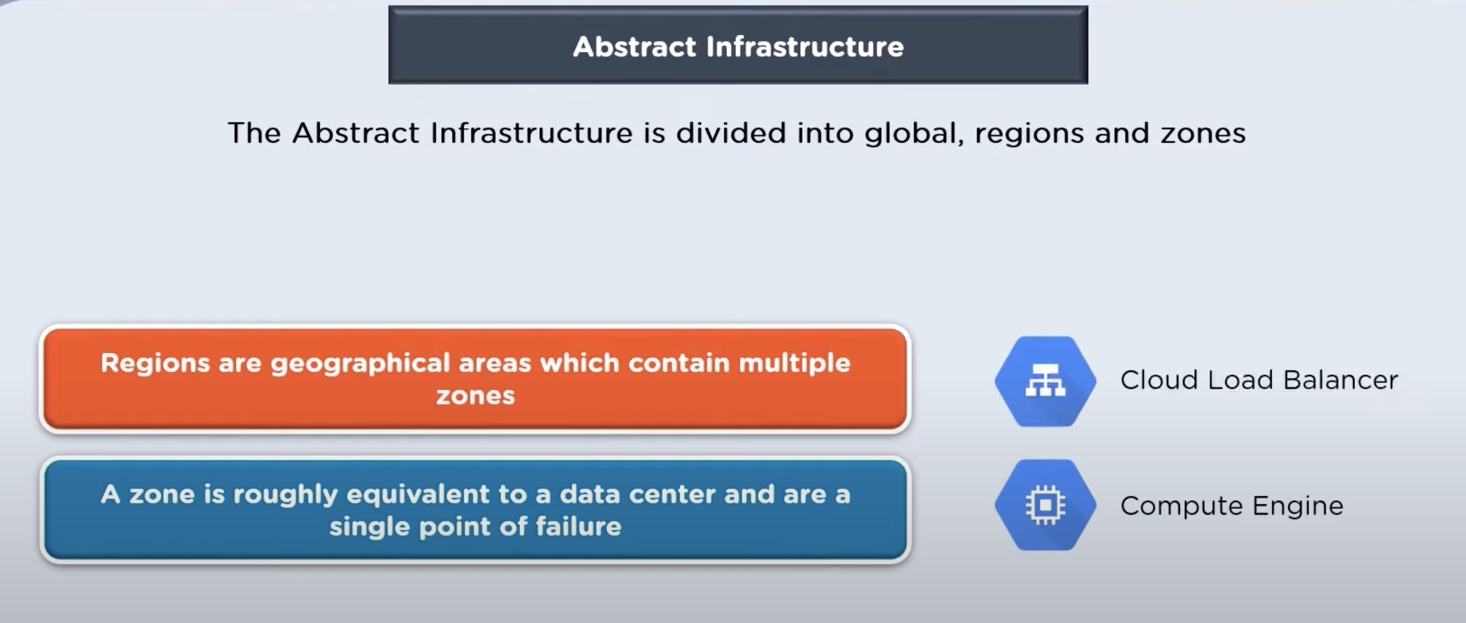
Google Infrastructure

Slide 14
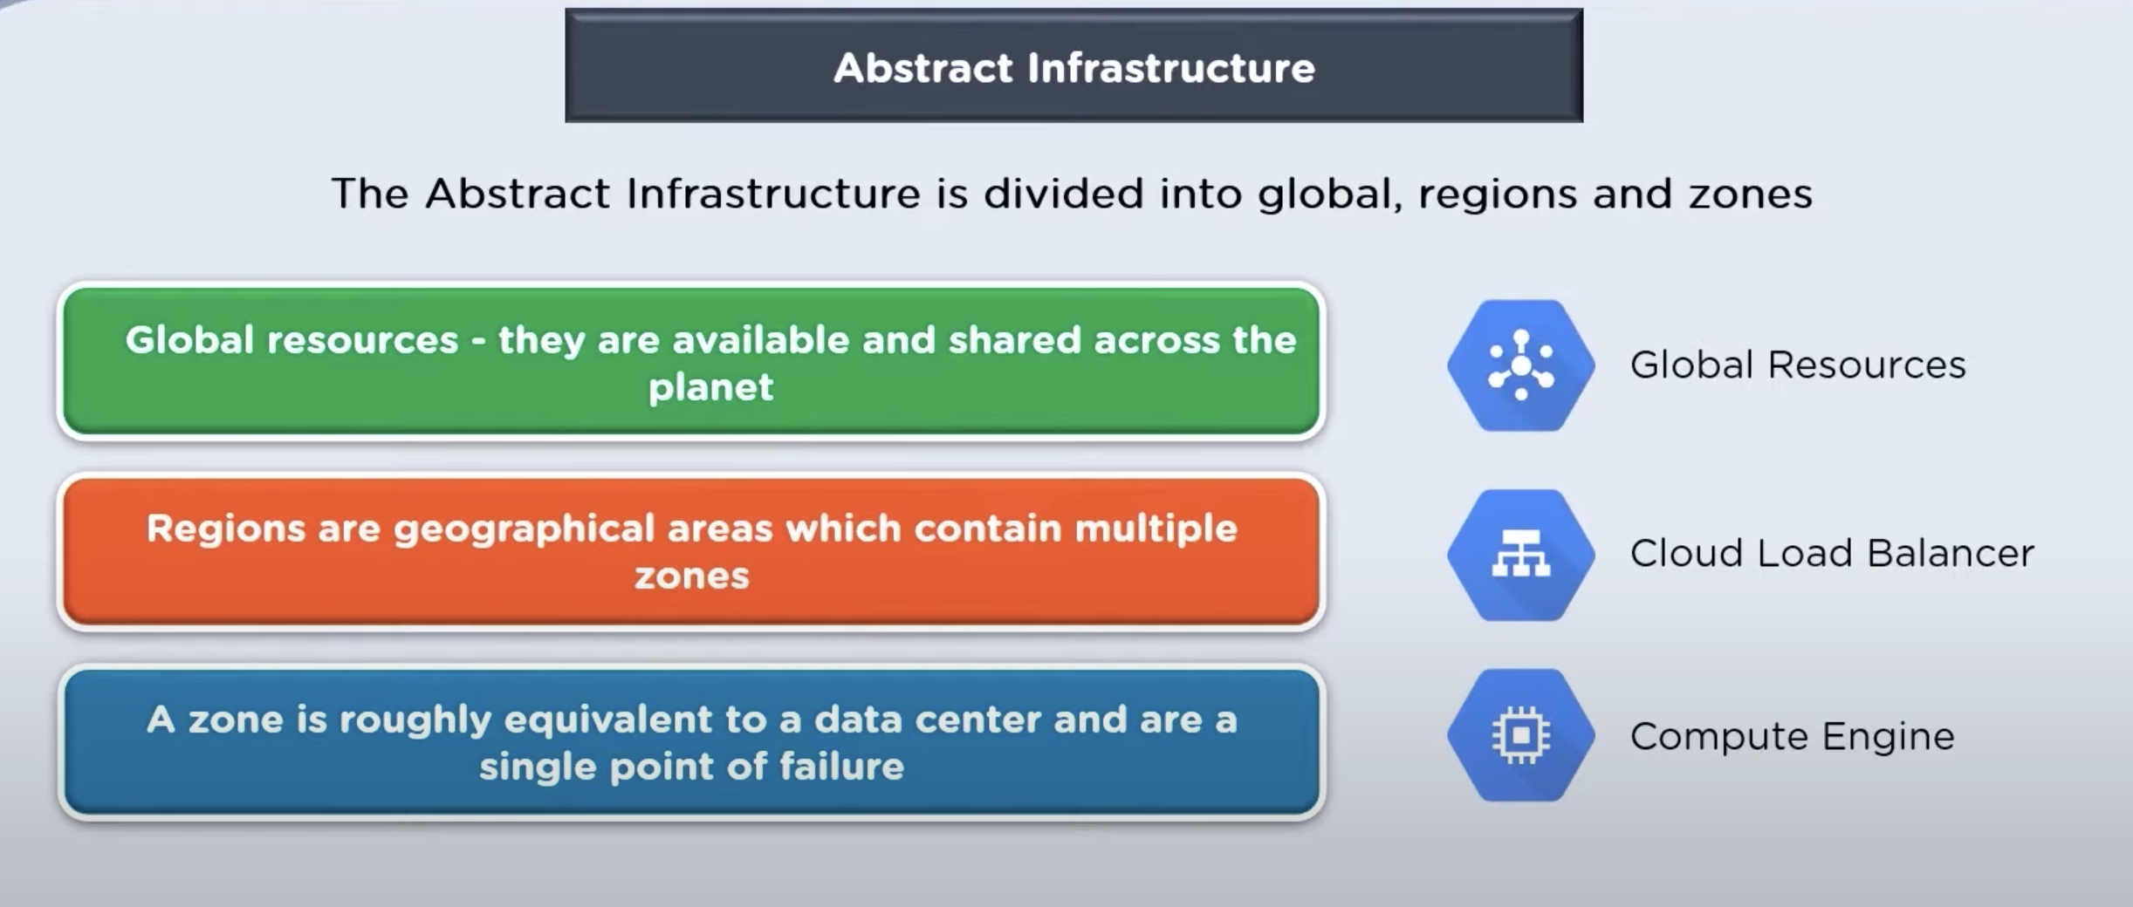
Google Infrastructure

